Slide 1
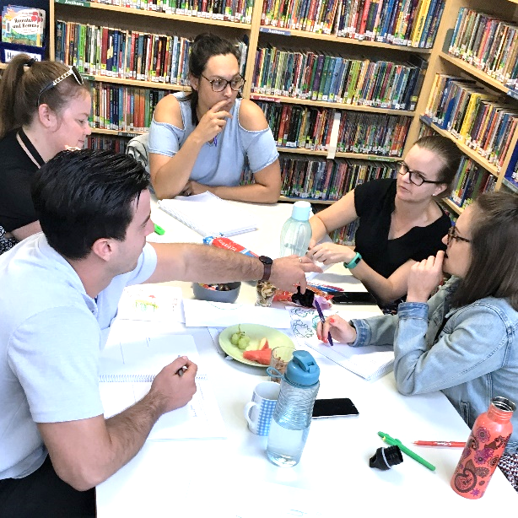
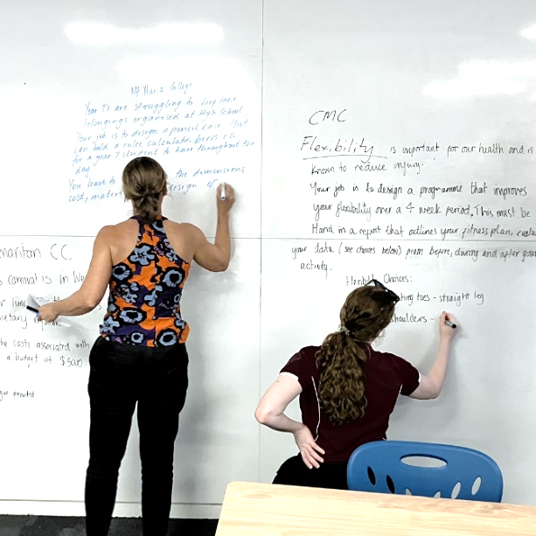
Unpacking AC9 Maths
4-6

Slide 2
Outline
Morning: Explore the content, proficiency and model changes
Middle: What that means for assessment and reporting
Afternoon: Prioritising for our school context and planning for implementation
Afterwards: All notes, criteria etc. emailed to you.
Unpacking AC9 Maths
with Tierney Kennedy

Slide 3
The basics
6 Strands: Number, Algebra, Measurement, Space, Probability, and Statistics. However… not all of them are in all year levels.
Achievement standards: describe the “C” standard, align closely with each content descriptor, and embed the proficiency strands. They have 3 paragraphs, aligning to the content strands above.
Content descriptors: now embed proficiency strands.
Elaborations: give clear examples of the content so that it is unmistakable, as well as contexts for use. Not mandated.
Mathematical processes: modelling, computational thinking, statistical investigations, probability experiments and simulations
Unpacking AC9 Maths
with Tierney Kennedy

Slide 4
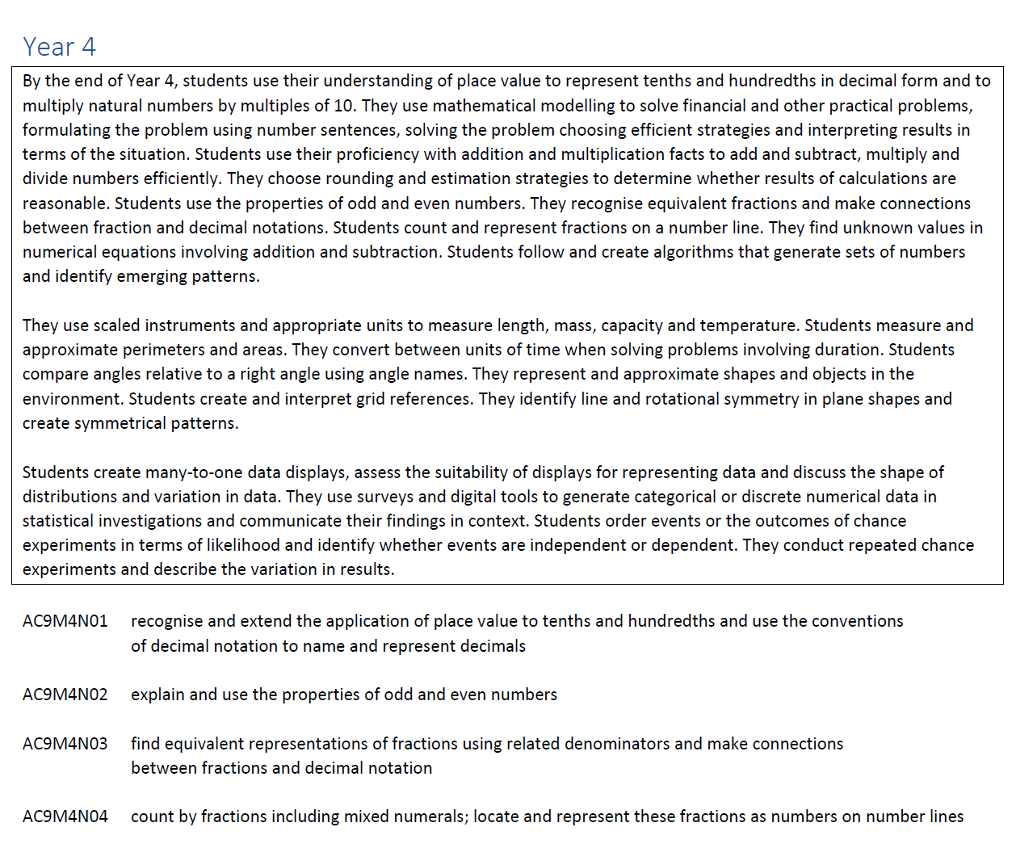
Introduction
Your first task:
Read through the achievement standard and content descriptors.
List anything that stands out to you – changes, focus, content…
What is missing?
Unpacking AC9 Maths
with Tierney Kennedy

Slide 5
Content, Actions, Models and Vocab
Your task:
Using the Content, Actions, Models + Vocab chart, break down each of the “Number” content descriptors for your year level.
AC9M5N01 interpret, compare and order numbers with more than 2 decimal places, including numbers greater than one, using place value understanding; represent these on a number line
Content | Actions | Models + Vocab
Numbers with more than 2 decimal places (including numbers greater than 1) | Interpret Compare Order Represent | Place value understanding Number line
Unpacking AC9 Maths
with Tierney Kennedy

Slide 6
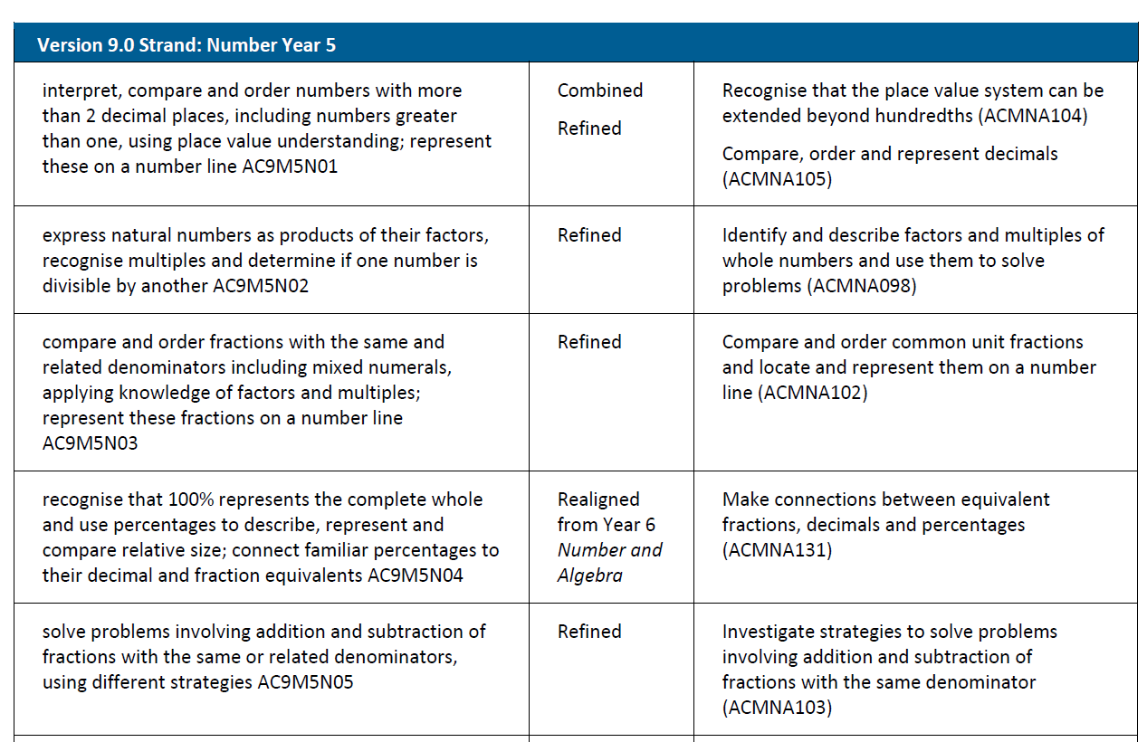
Align and compare
Your task:
Use your Content, Actions, Models findings, together with the comparison document to examine the AC8.4 vs 9.0 comparison sheets, so you compare all 3 aspects.
What changes are apparent in each of the columns?
Add any notes that you need or highlight the changes.
Reflect:
Which of these changes do you think will be the biggest for your school? Which do you think will be the most important?
Unpacking AC9 Maths
with Tierney Kennedy

Slide 7
Reflection and sharing our findings
Reflect:
Why do you think I had you do the break down first instead of just starting with the comparison document?
What does this mean for your school?
For your year level, what 3 changes do you think will be the most important or significant for teachers to understand?
Share:
For my year level, what are the most important changes that other year levels will need to know about?
Unpacking AC9 Maths
with Tierney Kennedy

Slide 8
My quick summary of F-3
Far more emphasis on proficiency strands. Focus on quantifying, comparing, partitioning rather than counting.
Number values are at a higher level (F: >20, 1: >120, 2: >1000, 3: >10 000) and so is addition and subtraction (F: within 10, 1: to 20, 2: to 100 including regrouping). Recall x÷ starts at year 2.
Whole number place value stops at year 3… so >10 000 means all whole numbers. Note: SA will probably still have it in year 4.
Money tends to be a context beyond year 3.
Fractions and clocks delayed to year 2.
Chance delayed until year 3. Data has far more emphasis.
Flips, slides and turns delayed.
Modelling and algorithms are new requirements.
Unpacking AC9 Maths
with Tierney Kennedy

Slide 9
My quick summary of 4-6
Far more emphasis on proficiency strands. Focus on comparing, connecting, multiplicative thinking and number lines.
Multiplying and dividing by powers of 10 starts at year 4.
Money is only a context. It’s linked with modelling requirements.
Estimation (number) and algorithms (algebra) are requirements.
Volume (3D) is gone. Patterns with fractions and decimals is gone.
Data is at a far higher level and requires conducting statistical investigations. Line graphs are in year 5 (!!)
Chance includes tricky concepts far earlier, but delays theoretical probability (4: variation and dependence; 5: repeated experiments, not-equal outcomes, frequency and estimating likelihood; 6: probability, simulations, variations across numbers of trials)
Unpacking AC9 Maths
with Tierney Kennedy

Slide 10
What that means for assessment
Your task:
Read through the achievement standard. Use the Content, Actions and Models form to unpack what it means to be “at standard”.
Compare this to your previous form. Highlight any additional Content, Actions and Models that were in the content descriptors but not in the achievement standard. These describe content and process that are “in addition to the standard” and can be therefore thought about as describing a higher standard.
Try writing a description for one area of what you would use to distinguish between “at standard” and “above standard”.
Unpacking AC9 Maths
with Tierney Kennedy

Slide 11
What that means for assessment
Examine the proficiency strand processes. Which ones can you find in your achievement standard? Highlight them in one colour or fill in the column on the sheet.
Which proficiency strand processes can you find in your content descriptors that are in addition to those in your achievement standard? Highlight them in a different colour.
Let’s share our results for each year level.
Unpacking AC9 Maths
with Tierney Kennedy

Slide 12
My summary of processes
 | Process within the proficiency strand | F | 1 | 2 | 3 | 4 | 5 | 6
Fluency | answer robustly
 | apply concepts | 1 | 1 | 1 | 1 | 1 | 1 | 1
 | choose representations or and approximations |  |  | 1 | 1 | 1 | 1 | 1
 | definitions, facts, theorems |  |  | 1 | 1 | 1 | 1 | 1
 | manipulate mathematical objects, expressions, relations, equations | 1 | 1 | 1 | 1 | 1 | 1 | 1
 | procedures or strategies: carry out procedures accurately, appropriately | 1 | 1 | 1 | 1 | 1 | 1 | 1
 | procedures or strategies: carry out procedures flexibly, efficiently |  |  |  | 1 | 1 | 1 | 1
 | procedures or strategies: choose appropriately |  | 1 | 1 | 1 | 1 | 1 | 1
 | procedures or strategies: connect understanding to learned strategies and procedures | 1 | 1 | 1 | 1 | 1 | 1 | 1
 | Skills: develop, practise, consolidate |  | 1 | 1 | 1 | 1 | 1 | 1
Unpacking AC9 Maths
with Tierney Kennedy

Slide 13
My summary of processes
 | Process within the proficiency strand | F | 1 | 2 | 3 | 4 | 5 | 6
Problem solving | problems: apply strategies and heuristics | 1 | 1 | 1 | 1 | 1 | 1 | 1
 | problems: check validity of approach |  |  |  |  |  | 1 | 1
 | problems: do not immediately know the answer
 | problems: formulate or represent situations mathematically | 1 | 1 | 1 | 1 | 1 | 1 | 1
 | problems: identify and create problems |  |  |  | 1 | 1 | 1 | 1
 | problems: mathematical and real world or practical problems | 1 | 1 | 1 | 1 | 1 | 1 | 1
 | problems: plan how to solve |  |  |  |  | 1 | 1 | 1
 | solutions: analyse |  |  |  |  | 1 | 1 | 1
 | solutions: communicate | 1 | 1 | 1 | 1 | 1 | 1 | 1
 | solutions: communicate with reference to the situation |  |  | 1 | 1 | 1 | 1 | 1
 | solutions: evaluate with regard to context |  |  |  |  |  | 1 | 1
 | solutions: interpret in terms of context |  |  | 1 | 1 | 1 | 1 | 1
 | solutions: justify reasonableness |  |  |  |  |  |  | 1
 | solutions: make decisions mathematically
 | solutions: review and check |  |  |  |  |  | 1 | 1
Unpacking AC9 Maths
with Tierney Kennedy

Slide 14
My summary of processes
 | Process within the proficiency strand | F | 1 | 2 | 3 | 4 | 5 | 6
Reasoning | adapt known to unknown
 | analyse |  |  |  |  | 1 | 1 | 1
 | compare and contrast related ideas | 1 | 1 | 1 | 1 | 1 | 1 | 1
 | deduce
 | evaluate |  |  |  |  |  | 1 | 1
 | experiment or investigate |  |  |  | 1 | 1 | 1 | 1
 | explain | 1 | 1 | 1 | 1 | 1 | 1 | 1
 | generalise
 | infer
 | justify |  |  |  |  |  |  | 1
 | logical thought and actions | 1 | 1 | 1 | 1 | 1 | 1 | 1
 | model |  | 1 | 1 | 1 | 1 | 1 | 1
 | prove true or false
 | reflect on choices | 1 | 1 | 1 | 1 | 1 | 1 | 1
 | transfer learning to a new context
Unpacking AC9 Maths
with Tierney Kennedy

Slide 15
My summary of processes
 | Process within the proficiency strand | F | 1 | 2 | 3 | 4 | 5 | 6
Understanding | adapt
 | apply familiar to develop new ideas |  |  |  |  | 1 | 1 | 1
 | connect: ideas, why and how, different concepts | 1 | 1 | 1 | 1 | 1 | 1 | 1
 | cultivate new ideas |  |  |  |  | 1 | 1 | 1
 | describe thinking mathematically | 1 | 1 | 1 | 1 | 1 | 1 | 1
 | identify commonalities and differences | 1 | 1 | 1 | 1 | 1 | 1 | 1
 | interpret mathematical information |  | 1 | 1 | 1 | 1 | 1 | 1
 | relate | 1 | 1 | 1 | 1 | 1 | 1 | 1
 | represent concepts in different ways | 1 | 1 | 1 | 1 | 1 | 1 | 1
 | transfer
Unpacking AC9 Maths
with Tierney Kennedy

Slide 16
Designing questions from the criteria
Your task:
Examine the criteria sheets and choose one area to focus on.
Design a task that would help you to know if a student was performing at standard, above standard, or not yet at standard.
Create a description, list of points, or list of questions that would help you to make that judgement. We will all share the tasks.
Unpacking AC9 Maths
with Tierney Kennedy

Slide 17
Reporting: A standard
Student success criteria:
I solved hard problems that had lots of steps by developing my own strategies.
Before solving the problem, I looked for patterns and did some experimenting. I used my findings to plan what to do to solve the problem.
I changed my steps when they didn’t work. I showed how/why my steps worked.
I found a rule or approach that I could use to solve other problems too.
Report card comment:
This student has produced work that is well-above the expected standard for this year level. They have consistently solved challenging and multistep problems, that required invention of strategies and thinking. They have connected related concepts in mathematics, deduced underlying patterns and generalised these into principles. They have used mathematical processes efficiently, accurately, and effectively to reach solutions and provided solid proof or justification for conclusions.
Unpacking AC9 Maths
with Tierney Kennedy

Slide 18
Reporting: B standard
Student success criteria:
I solved problems with a few steps by adapting strategies that I had been taught.
When starting the problem, I looked for patterns and planned some steps.
I checked my steps worked.
I explained my steps and gave good reasons for choosing them.
Report card comment:
This student has produced work that is above the expected standard for this year level. They have consistently solved multistep problems, by adapting or applying previously learned strategies in a more complex manner. They have linked some related concepts in mathematics. They have used mathematical processes accurately and effectively to reach solutions and explain conclusions, and were able to provide some justification for conclusions reached.
Unpacking AC9 Maths
with Tierney Kennedy

Slide 19
Reporting: C standard
Student success criteria:
I used a process that I had been shown to solve problems. The problems had one or two steps.
I checked my answer.
I showed my steps and how I got my answer.
Report card comment:
This student has produced work that is at the expected standard for this year level. They have consistently solved familiar problems with one or two steps by directly applying previously learned steps and strategies. They have used mathematical processes appropriately to reach solutions and discuss conclusions.
Unpacking AC9 Maths
with Tierney Kennedy

Slide 20
Reporting: D standard
Student success criteria:
I used a process that I had been shown to try and solve a problem.
My process was on the right track, but it didn’t quite work, so my answer was wrong.
With some help, I explained my process and tried to fix it.
Report card comment:
This student has produced work that is not yet at the expected standard for this year level. This student sometimes solved simple, familiar problems with one or two steps when guidance and support were provided. This student sometimes used mathematical processes appropriately to reach solutions or to partly solve problems, however the level of accuracy shown was not yet at the expected standard.
Unpacking AC9 Maths
with Tierney Kennedy

Slide 21
Reporting: E standard
Student success criteria:
I attempted to solve the problem, but I didn’t really understand it. Often, I just guessed because I didn’t know what to do.
With some help I could understand why my answer was wrong.
Report card comment:
This student has produced work that is below the expected standard for this year level. Substantial guidance was provided for this student to solve straightforward problems and use mathematical processes appropriately. This student occasionally used appropriate principles to solve simple and routine questions with support, however the solutions provided were often inaccurate.
Unpacking AC9 Maths
with Tierney Kennedy

Slide 22
Reflection and sharing our findings
Reflect and Share:
What have you learned about assessment for your year level that you think will be important for your team back at school?
What changes do you think will be the most important or significant for teachers from other year levels to understand?
Unpacking AC9 Maths
with Tierney Kennedy

Slide 23
Our school plan
Your task:
Read back through your notes. Which areas have you flagged at the most important for your school?
List 4-5 elements that you think your teachers will need to engage with or sessions that you think you might need to run.
Order the sessions – make sure that the most important elements happen first so that you have the longest possible time to implement them.
What can you realistically do in the next 6 months? Create a timeline for your steps.
Take the first two elements and plan them out.
Unpacking AC9 Maths
with Tierney Kennedy

Slide 24
My recommendations for implementing
You will need multiple times to teach place value in the first few years to get to the higher levels. Spread it across multiple terms to build up to bigger numbers throughout the year rather than all at once.
When sequencing, group similar concepts together (e.g. length with number lines, area with multiplication, fractions with division, money with algebra).
Multiplicative thinking is a much bigger deal. Allow time. You also need a whole time devoted just to division.
Do not leave chance/data until term 4 as it is much bigger now.
Unpacking AC9 Maths
with Tierney Kennedy

Slide 25
My recommendations for implementing
The proficiency strands cannot be an “added extra”. To emphasise this, plan to break down the content, actions and models in a similar fashion to what we did.
Consider using just 3 columns for content assessment and check across a whole portfolio of work (above, at, not yet at standard)
Trial modelling tasks just as an extension first before using them with the whole class. Don’t mark the first task as it will likely be a disaster.
Start with number for junior primary. Start with data for upper primary. The geometry changes at all levels are fairly simple, but watch for the focus on comparison and classification.
Unpacking AC9 Maths
with Tierney Kennedy

Slide 26
My suggested sequence for content
Term 1 | Term 2 | Term 3 | Term 4
Revise place value Add and subtract + number lines Integers | Arrays: multiplication and structural thinking Big kids: Prime, composite, odd, even, Area Little kids: place value, add + subtract | Place value at year-level standard Fractions at year-level standard | Algebraic thinking and patterning, Cartesian plane Order of operations Money and modelling
Number-line concepts: Length Mass + Capacity Map scales or directions Time for older kids | Arrays: Division Revise fractions Clocks, angles (both are turns and link with fractions) Directions or shape/ objects | Data investigation Big kids: Probability Little kids: collect data on shapes/ objects and classify them | Big kids: Tricky geometry Little kids: place value at A/B levels
Unpacking AC9 Maths
with Tierney Kennedy

